Slide 1

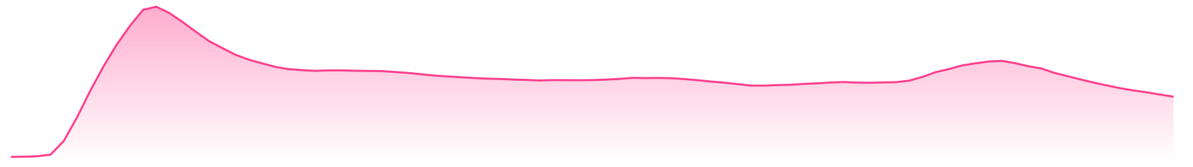




Film · 2025 · How it spread
KPop Demon Hunters
Netflix reported 600M+ views as the film’s songs spread through fan clips and covers.
Spread Score
Impressions
Peak date
Platforms
74
4.6B
Week of Aug 31, 2025
6
Wikipedia views, 7-day average
148.3K/day
Seed
Jun 20 ’25
Platform jump
Press
Jul 29 ’25
Peak
Netflix
Week of Jun 20, 2025
Associated Press
Week of Aug 31, 2025
Fans
Netflix
howitspread.com/cases/kpop-demon-hunters
Media: Netflix on YouTube
Notes:
How KPop Demon Hunters spread. Netflix reported 600M+ views as the film’s songs spread through fan clips and covers.
Case: https://howitspread.com/cases/kpop-demon-hunters

