Slide 1
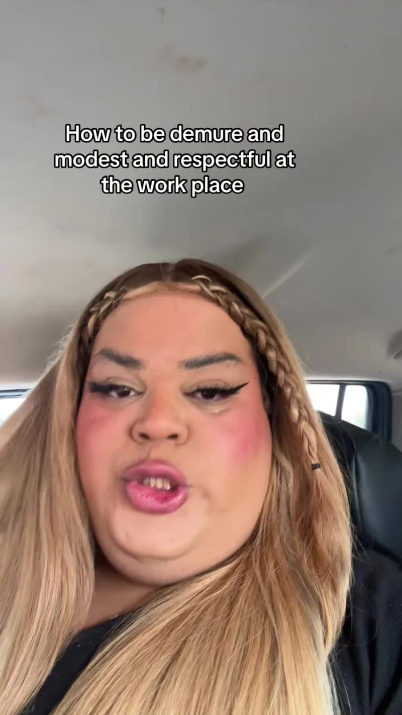






Creator moment · 2024 · How it spread
Very demure, very mindful
Jools Lebron's 'very demure, very mindful' TikTok drew 35 million views.
Spread Score
Views
Seed to peak
Platforms
58
35M
2 weeks
5
Google search interest
Most searched
Seed
Aug 2 ’24
First amplifier
Aug 11 ’24
Platform jump
Aug 12 ’24
Press
Aug 14 ’24
Peak
Aug 17 ’24
Jools Lebron (@joolieannie)
Bob the Drag Queen
@mxniquejade_
NBC News
Brandwatch (social listening)
howitspread.com/cases/very-demure
Media: @joolieannie on TikTok
Notes:
How Very demure, very mindful spread. Jools Lebron's 'very demure, very mindful' TikTok drew 35 million views.
Case: https://howitspread.com/cases/very-demure

